Slide 1
Introduction to Adobe Illustrator
Mr. Hoering

Slide 2
Computer Graphics
Computer graphics fall into two main categories:
Vector graphics
Bitmap images

Slide 3
Vector Graphics
Adobe Illustrator creates vector graphics made of lines and curves defined by mathematical objects called vectors.
Vectors describe graphics according to their geometric characteristics.
For example, a bicycle tire in a vector graphic is made up of a mathematical definition of a circle drawn with a certain radius, set at a specific location, and filled with a specific color. You can move, resize, or change the color of the tire without losing the quality of the graphic.

Slide 4
Vector Graphics
A vector graphic is resolution-independent -- that is, it can be scaled to any size and printed on any output device at any resolution without losing its detail or clarity. As a result, vector graphics are the best choice for type (especially small type) and bold graphics that must retain crisp lines when scaled to various sizes -- for example, logos.

Slide 5
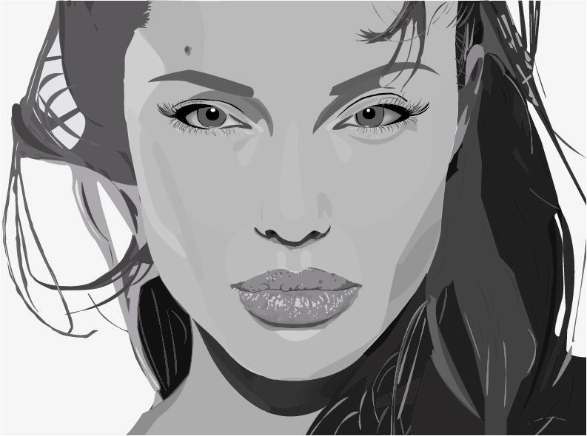

Slide 6
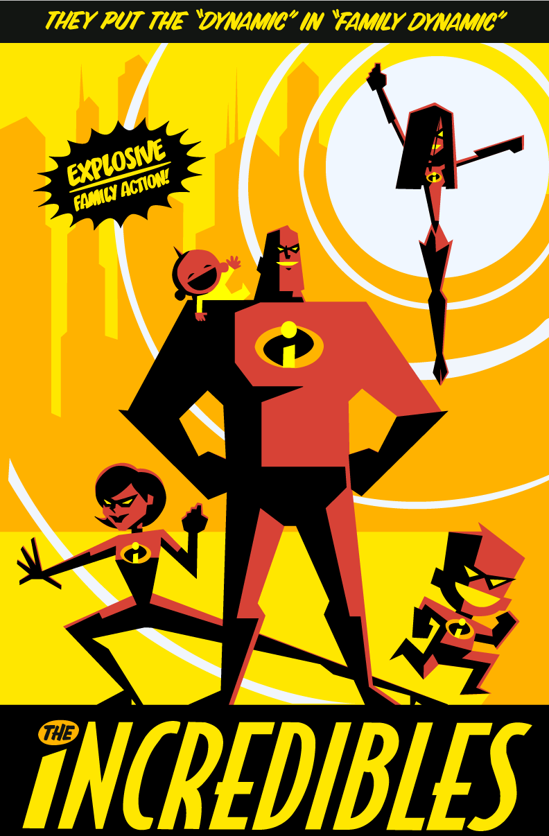

Slide 8
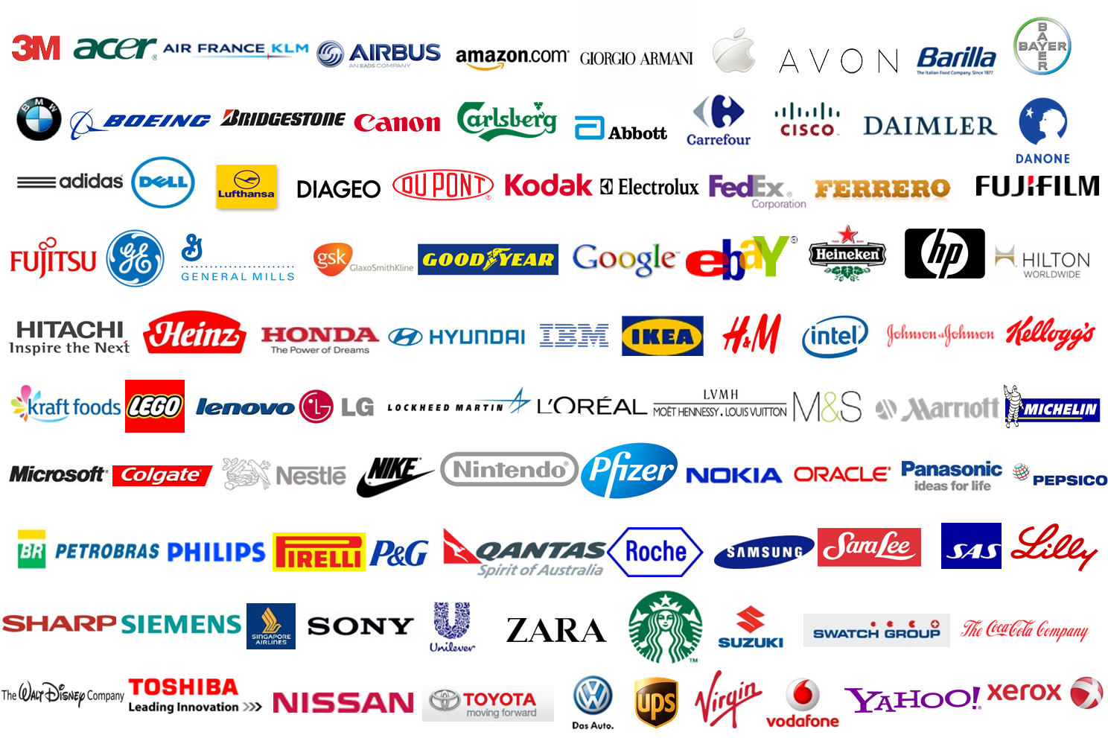

Slide 10
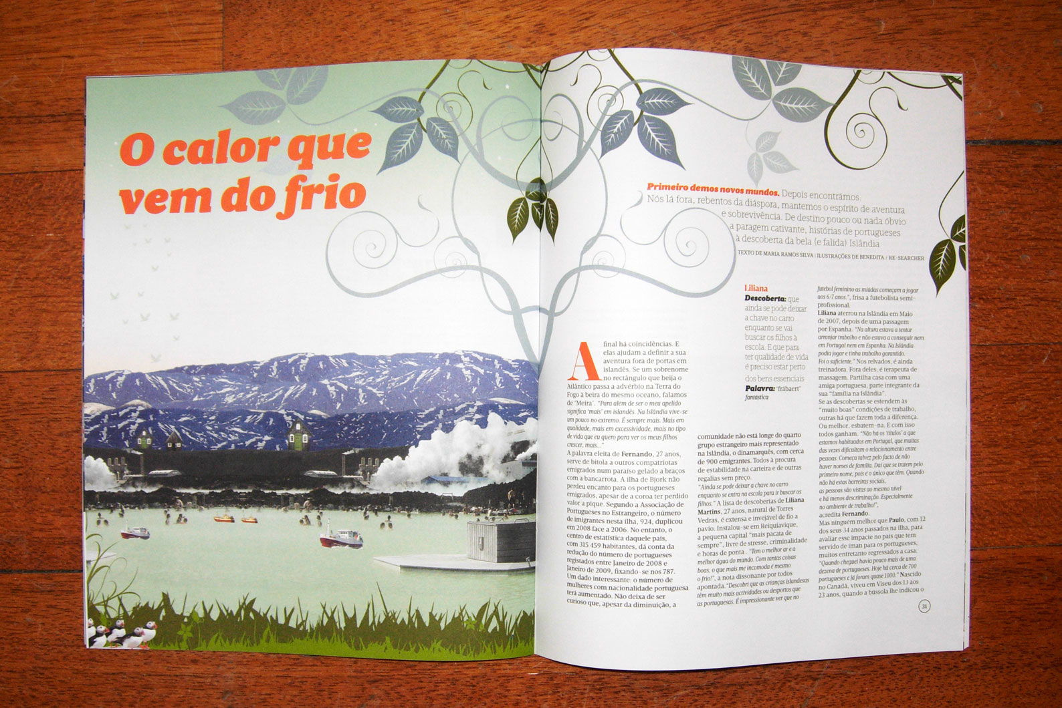

Slide 11
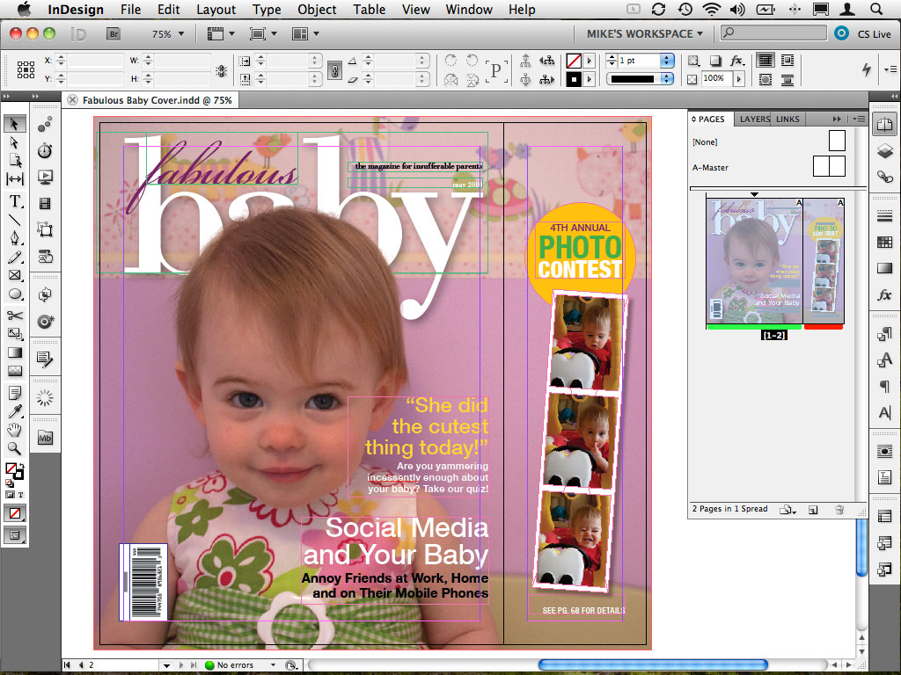

Slide 12
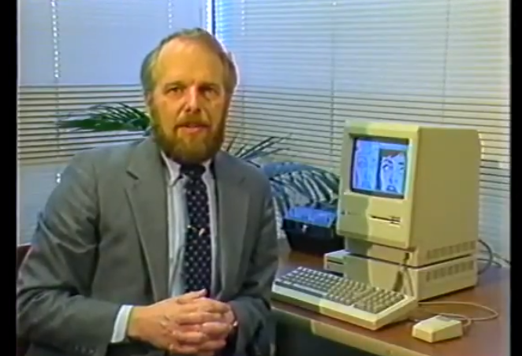
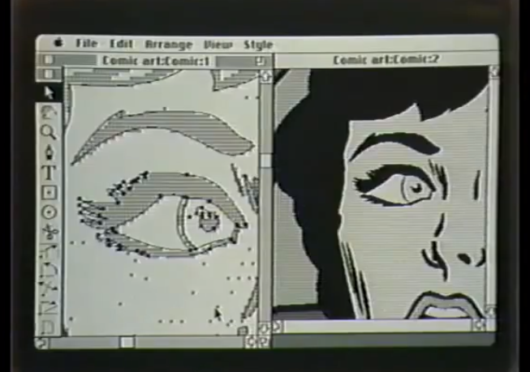
History of Adobe Illustrator
Adobe Illustrator was first developed for the Apple Macintosh in December 1986.
The latest version, Illustrator CS6, is the sixteenth generation in the product line.

Slide 14
Color Picker
Toolbox
Artboard
Status Bar

